Slide 1

Load Balancing in Azure Virtual Machines
Kishore Chowdary
@kishore_1702
kishorechowdary@codesizzler.info
+91 9159428433

Slide 2

Objective
Enter Text
Deploying Virtual Machines in Availability Set
Installing IIS Web Server in Azure Virtual Machine
Creating Load Balancer for Virtual Machines
Balancing the Load between Virtual Machines

Slide 3
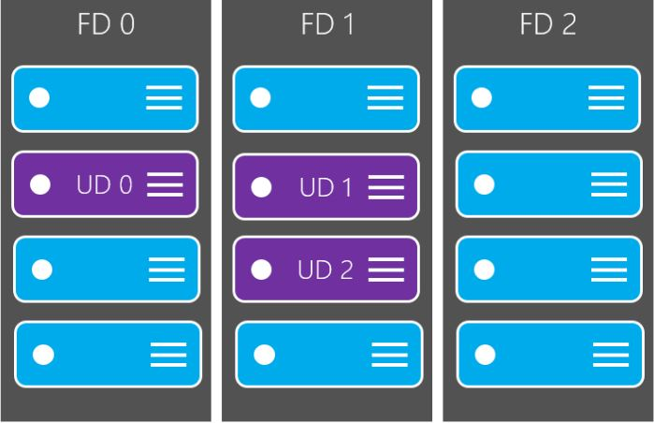
Availability Sets in Azure Virtual Machines
Enter Text

Slide 4
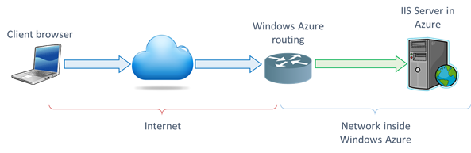
Installing IIS Web Server
Enter Text

Slide 5
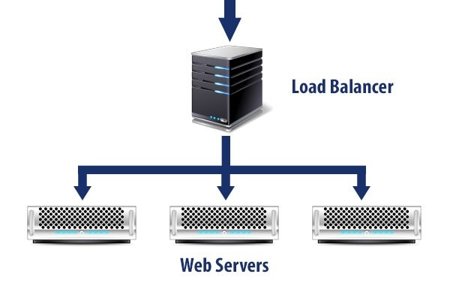
Creating Load Balancer
Enter Text

Slide 6
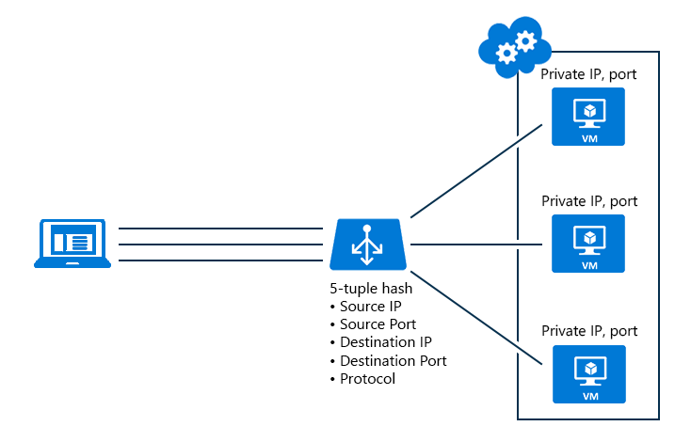
Balancing Load
Enter Text

Slide 7
Enter Text
Resources used in Balancing Load
Backend Pools
Public IP
Health Probe
Load Balancing Rules
Network Address Translation Rules

Slide 8
Enter Text
Demo – Load Balancer

Slide 9
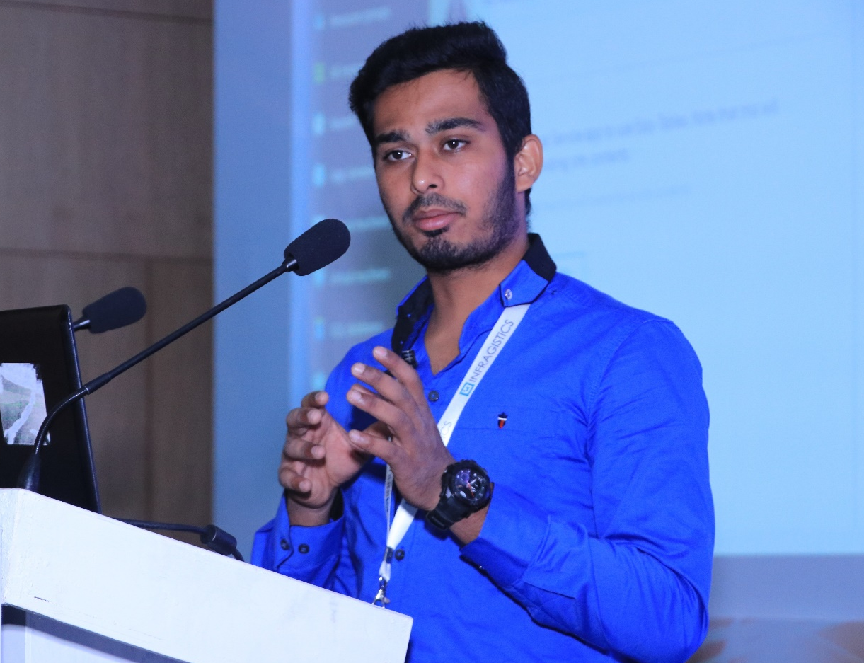
Enter Text
Thanks for Joining!!
Kishore Chowdary
Feel free to reach me for any queries:
@kishore_1702
kishorechowdary@codesizzler.info
+91 9159428433

